Slide 1
STRUCTURE BASED VIRTUAL SCREENING
If 3D structure of the target molecule is known, VS can be performed by molecular docking.
Molecular Docking is used to predict the binding orientation of small molecule (drug candidates) to their protein targets to form a stable complex and in turn predict the affinity and activity of the small molecule.
Molecular docking can be thought of as a problem of “lock-and-key”, where one is interested in finding the correct relative orientation of the “key” which will open up the “lock”
Here, the protein can be thought of as the “lock” and the ligand can be thought of as a “key”

Slide 2


A drug candidate…
... is a (ligand) compound that binds to a biological target (protein, enzyme, receptor, ...) and in this way either initiates a process (agonist) or inhibits it (antagonist)
The structure/conformation of the ligand is complementary to the space defined by the protein’s active site
The binding is caused by favorable interactions between the ligand and the side chains of the amino acids in the active site. (electrostatic interactions, hydrogen bonds, hydrophobic contacts...)

Slide 3
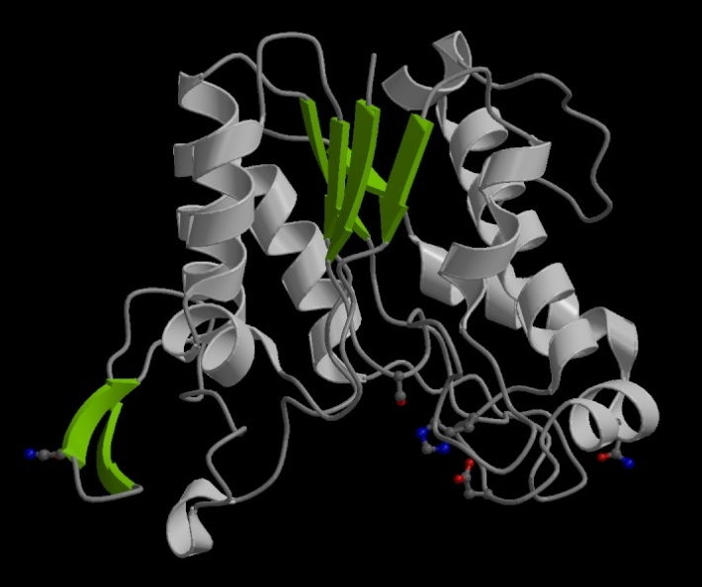
The Drug Discovery Process
We know the structure of the biological target
We identify/predict the binding pocket
MKTAALAPLFFLPSALATTVYLA
GDSTMAKNGGGSGTNGWGEYL
ASYLSATVVNDAVAGRSAR…(etc)
Challenge:
To design an organic molecule that would bind strong enough to the biological target and modute it’s activity.
New drug candidate

Slide 4
Docking methods use an energy based scoring function to identify the most energetically favorable conformation of a ligand when bound to macromolecular target.
Low energy scores indicate more favored protein -ligand complexes.
The task of docking method is to find the ligand binding mode with lowest potential energy.

Slide 5
Energy of binding
Binding pocket of target
Library of small compounds
-1 kcal/mol
-10 kcal/mol
+10 kcal/mol
+1 kcal/mol
ΔG = ΔH - TΔS
Torsional free E
vdW
Hbond
Desolvation E
Electrostatic E
Notes:
For any spontaneous change in a closed system, the change in [Gibbs] free energy equals the change in enthalpy minus the change in entropy times the temperature.

Slide 6
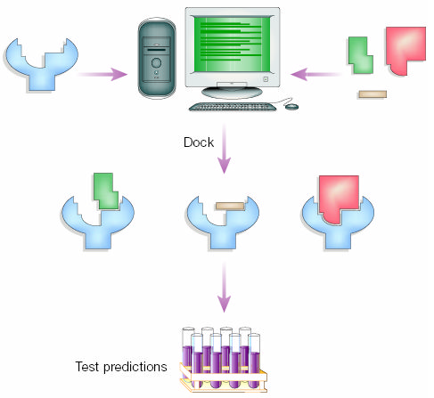
Goal: To be able to search a database of molecular structures and retrieve all molecules that can interact with the query structure

Slide 7
It is the key to rational drug design:
The results of docking can be used to find inhibitors for specific target proteins and thus to design new drugs. It is gaining importance as the number of proteins whose structure is known increases

Slide 8
Protein Structure
To perform docking, 3D structure of protein is required
X-ray diffraction
NMR

Slide 9
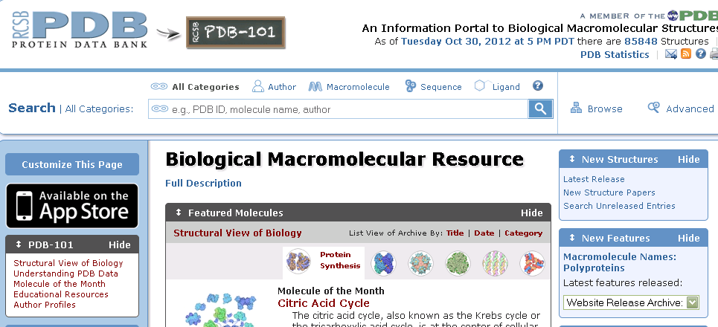
PROTEIN DATA BANK

Slide 10
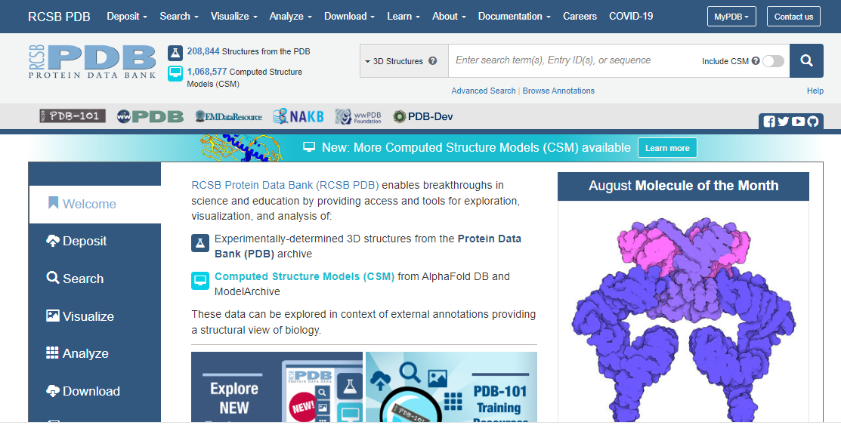

Slide 11
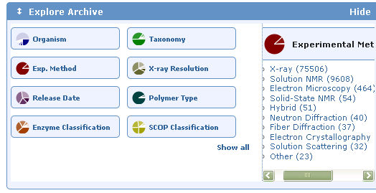

Slide 12
Target protein
Aldose reductase

Slide 13
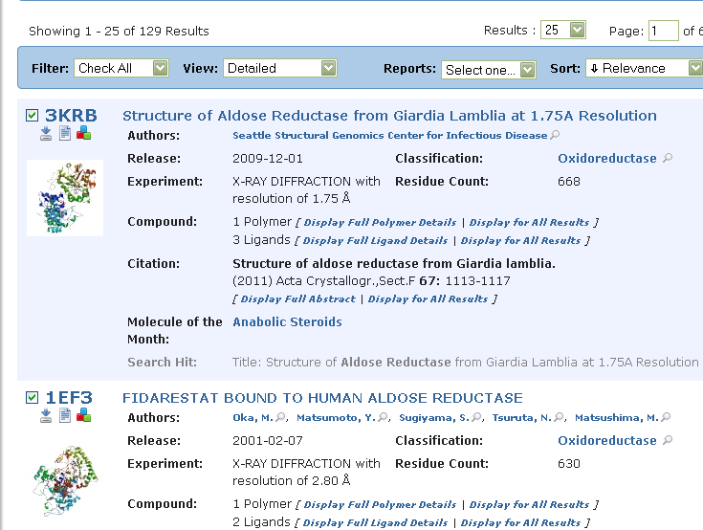

Slide 14
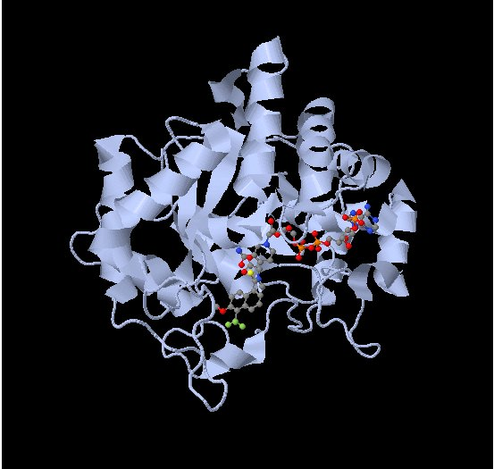
Crystal structure of Aldose reductase with tolrestat and NADPH (PDB code 2FZD)

Slide 15
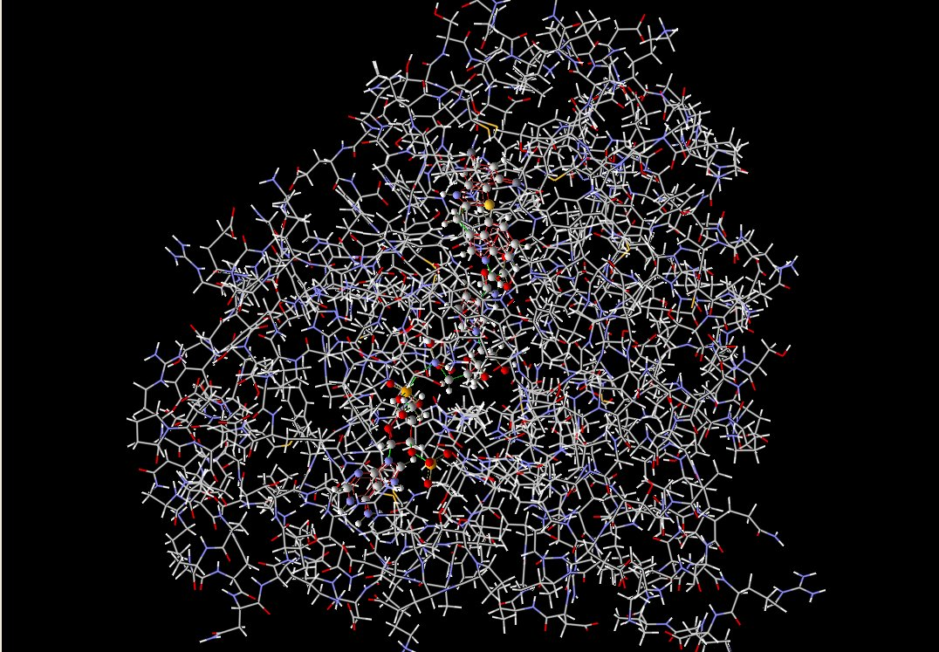
Download protein molecule (Aldose reductase)

Slide 16

Identification of structure of the receptor
May be identified by various literatures
Structure may be obtained form PDB
Study of the nature of the receptor
Finding the binding site for ligand
Crystal structure of tyrosine kinase(PDB ID 1Y6A)

Slide 17
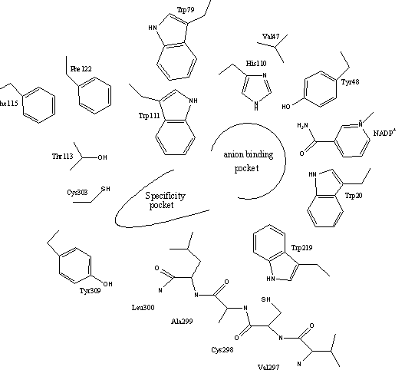
AR active site composed of 2 regions
An anionic binding site
Specificity(Hydrophobic) pocket

Slide 18
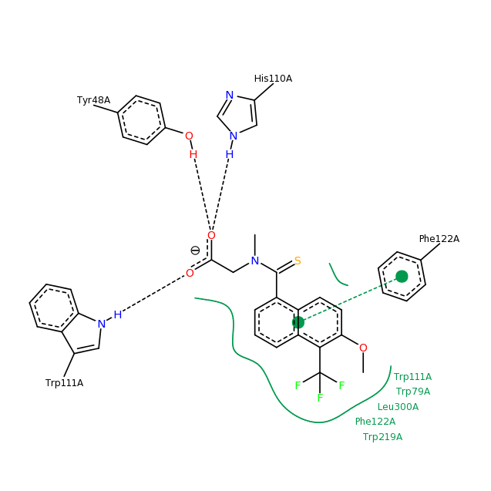
Ligand (tolrestat) Interactions in Crystal structure (2fzd) of AR

Slide 19
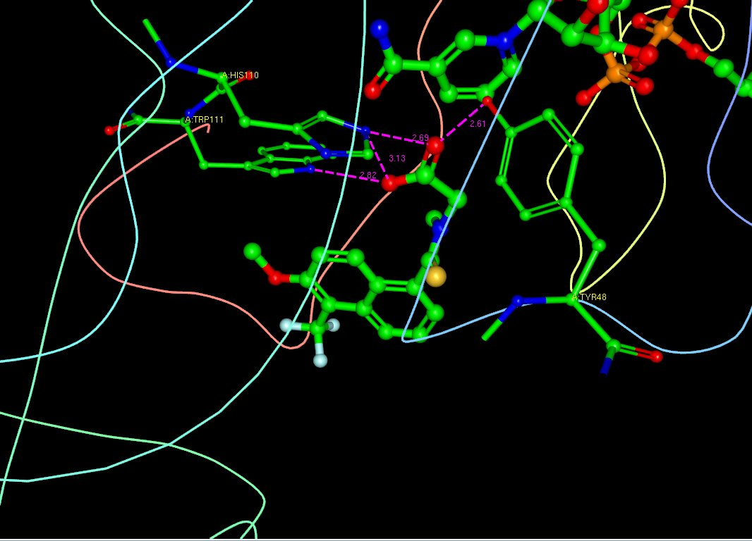
Ligand (tolrestat) Interactions in Crystal structure (2fzd) of AR

Slide 20
Docking Software
Gold
Dock
FlexX
Glide
LigandFit
Slide
AutoDock
Surflex
Molgro Virtual Docker (MVD)

Slide 21
Two main tasks of Docking Tools
Sampling of conformational (Ligand) space (Search algorithm)
Scoring protein-ligand complexes
(Scoring Function)

Slide 22
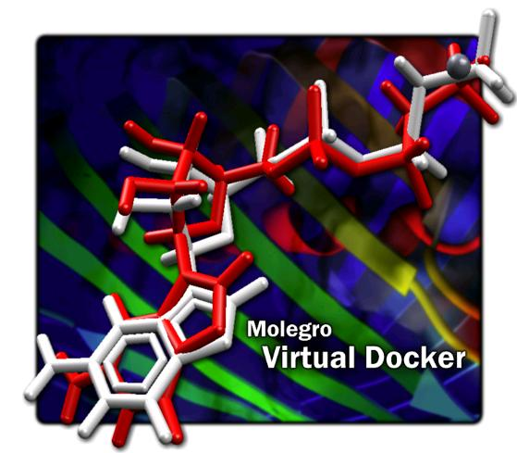

Slide 23
Download protein molecule (Aldose reductase)

Slide 24
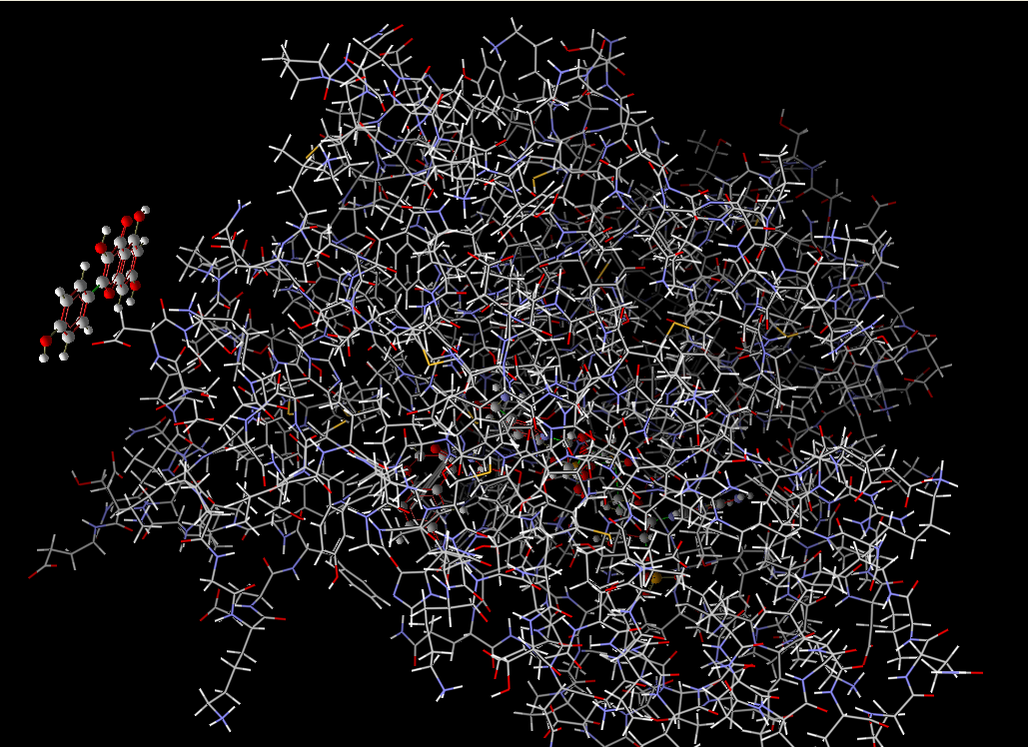
Import the ligand

Slide 25
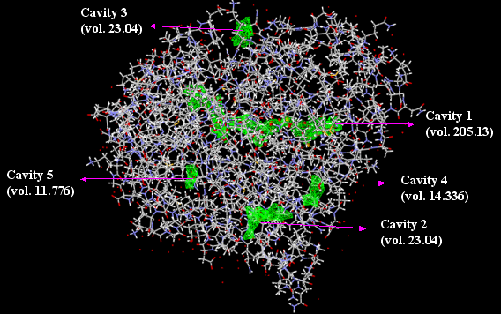
Detection of cavities

Slide 26
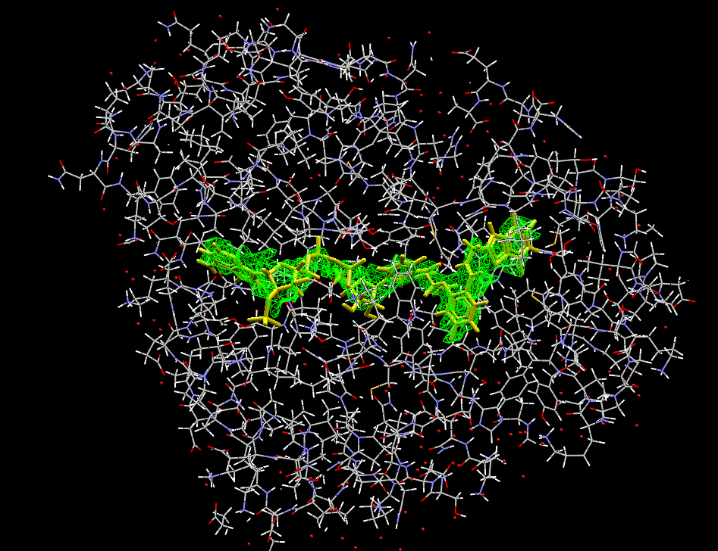
Select the appropriate cavity

Slide 27
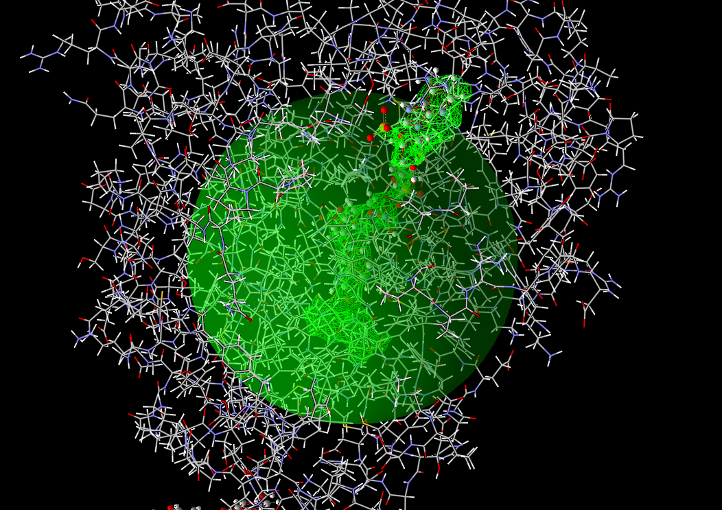
Creating constrain

Slide 28
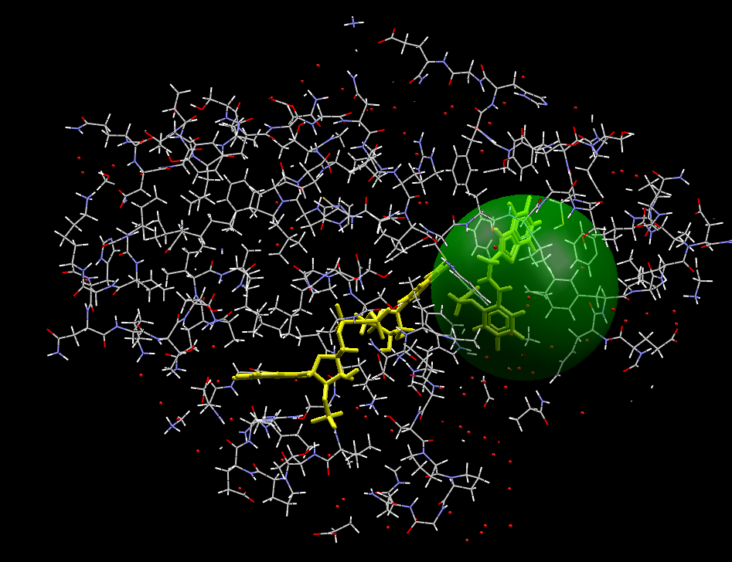
Manually defined search space sphere (radius 8 Å) to confine docking to the AR inhibitor binding site

Slide 29
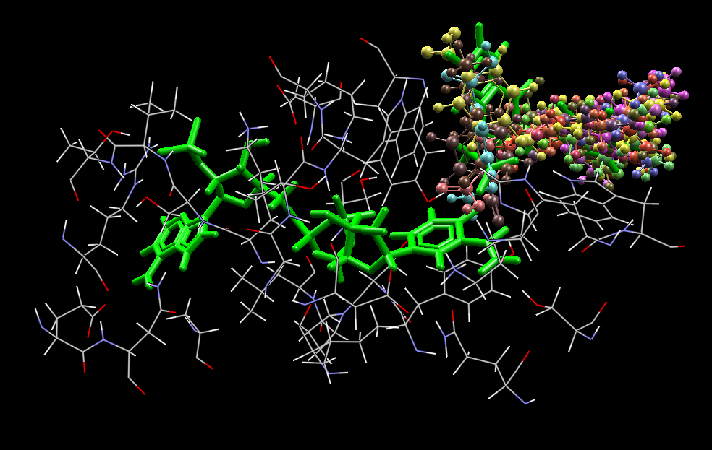
Pose Clustering

Slide 30
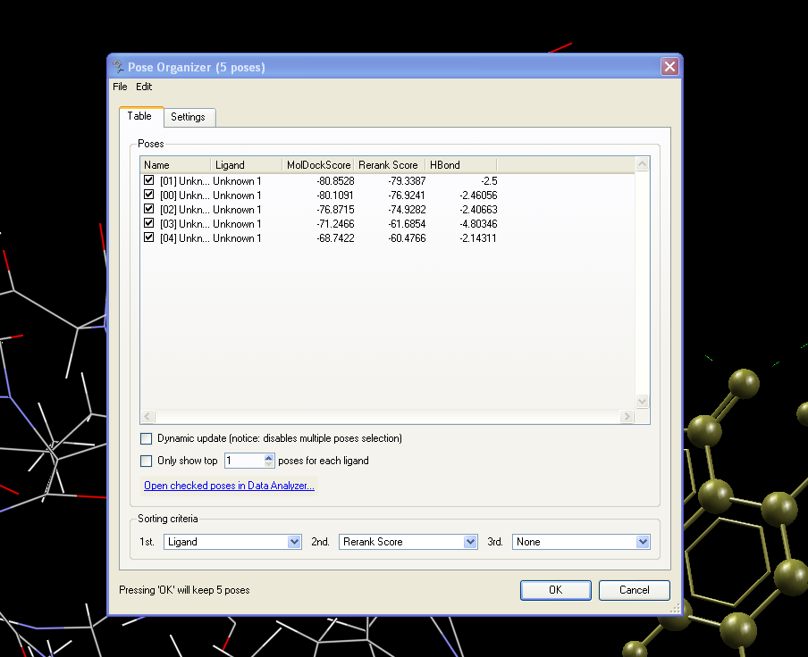
Docking result

Slide 31
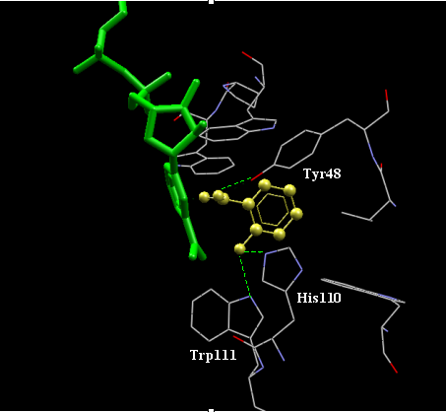
Docking results

Slide 32
Limitations
Water molecules
Protein flexibility

Slide 33
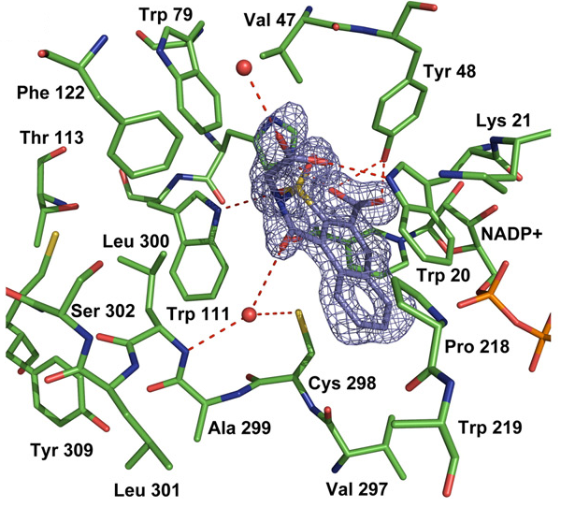
Include water molecules or not ?
Bridging water molecule

Slide 34
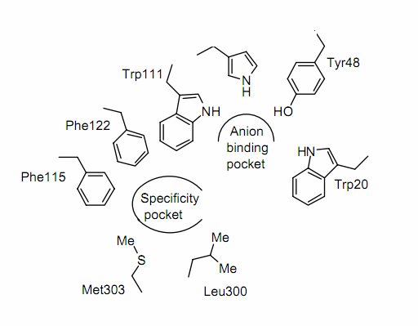
Protein Flexibility
Schematic representation of active site of aldose reductase

Slide 35
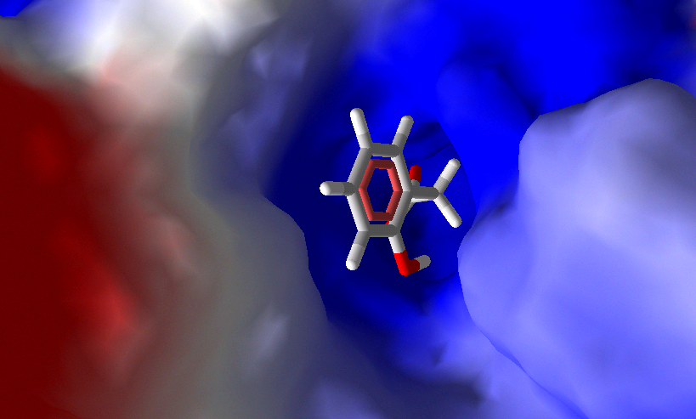
Crystal structure of aldose reductase (PDB code: 2INZ) where specificity pocket is closed (ligand :2 Phenylacetic acid; volume :495.3 Å³)

Slide 36
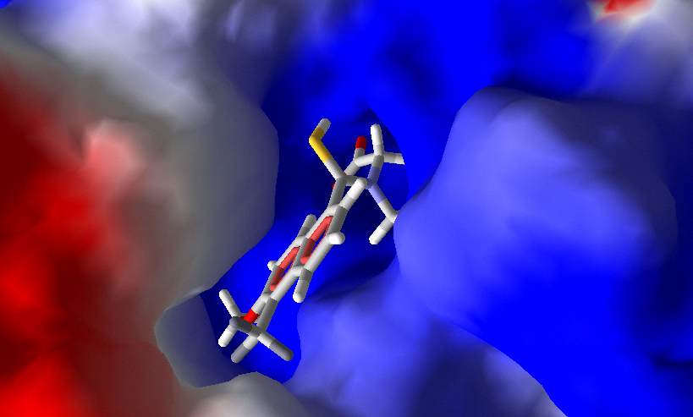
Crystal structure of aldose reductase (PDB code :2FZD) where specificity pocket is open (ligand :Tolrestat ;volume : 860 Å³)

Slide 37
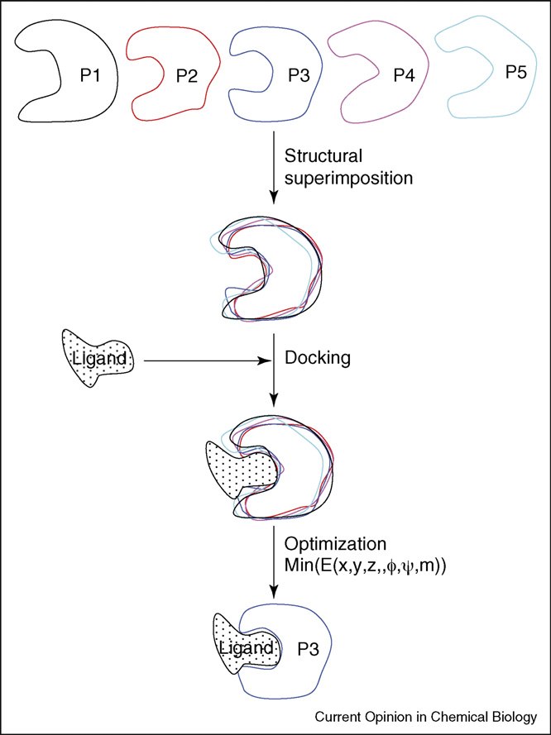

Slide 38
IHD compounds were docked against 10 different crystal structures of AR
S.No. | PDB Code | Ligand
1 | 1IEI | Zenarestat
2 | 2PZN | IDD393
3 | 2NVC | Naphthol (1,2)isothiazole acetic acid derivative 3
4 | 1US0 | IDD594
5 | 2INZ | 2Hydroxyphenylacetic acid
6 | 2NVD | Naphtholisothiazol actic acid
7 | 1T40 | IDD552
8 | 2IKG | Nitrophenyl oxadiazole type inhibitor
9 | 2FZD | Tolrestat
10 | 1Z3N | Lidorestat
Crystal structure of AR from PDB used for docking

Slide 39
IHD compounds | Averag MVD score (kcal/mol)
Chlorogenic acid | -113.83 ± 16.6
Glutathione | -105.72 ± 7.3
Gamma glutamyl phenylalanine | -101.20 ± 9.3
Eicosapentanoic acid | -94.66 ± 10.1
Santalbic acid | -94.07 ± 9.1
Piperonic acid | -93.87 ± 8.4
Punicic acid | -92.09 ± 6.0
Palmitoleic acid | -91.21 ± 9.1
Ambrettolic acid | -90.99 ± 11.0
Rhein | -90.41 ± 10.9
Stearolic acid | -90.08 ± 8.1
Petroselinic acid | -89.42 ± 7.2
Gamma glutamylleucine | -88.66 ± 9.8
Abscissic acid | -87.76 ± 6.8
Gamma glutamylcysteine | -87.30 ± 7.7
Tridecanoic acid | -85.99 ± 5.9
Myristic acid | -85.52 ± 8.4
Gamma glutamylvaline | -85.43 ± 8.7
IHD compounds | Average MVD score (kcal/mol)
Pentadecanoic acid | -84.96 ± 7.7
Abrine | -84.08 ± 7.6
Sinapic acid | -82.49 ± 6.3
Lauric acid | -82.40 ± 6.5
Ferulic acid | -80.76 ± 5.1
Caffeic acid | -80.48 ± 7.1
Citrullin | -73.53 ± 4.5
Syringic acid | -72.84 ± 6.9
p-Coumaric acid | -72.29 ± 5.1
Capric acid | -72.09 ± 5.9
o-Coumaric acid | -71.88 ± 5.3
Aconitic acid | -70.85 ± 4.9
Gallic acid | -70.79 ± 5.5
Citric acid | -70.71 ± 5.6
Isocitric acid | -70.57 ± 5.5
Vanillic acid | -70.15 ± 7.1
o-Acetylsalicylic acid | -69.51 ± 6.6
Phloroglucinol | -68.75 ± 6.5
Shikimic acid | -67.48 ± 4.8

Slide 40
IHD compounds | Average MVD score (kcal/mol)
Nonanoic acid | -67.29 ± 4.5
Protocatechuric acid | -66.44 ± 5.5
Gentisic acid | -66.42 ± 6.1
Methylene glutamine | -66.23 ± 4.8
Cinnamic acid | -66.07 ± 4.7
Methionine sulfone | -65.35 ± 5.0
Alliin | -65.29 ± 2.8
Phenylpropionic acid | -65.00 ± 5.5
Anisic acid | -64.50 ± 5.7
S-Allyl cysteine | -64.15 ± 5.4
Caprylic acid | -63.63 ± 4.2
Salicylic acid | -60.62 ± 4.8
Tartaric acid | -60.60 ± 4.5
Mevalonic acid | -60.10 ± 3.7
Phenylacetic acid | -59.49 ± 4.5
Cycloalliin | -59.43 ± 3.7
Malic acid | -58.69 ± 4.0
Ornithine | -57.62 ± 3.9
Benzoic acid | -57.08 ± 5.6
IHD compounds | Average MVD score (kcal/mol)
Seleno methionine | -57.06 ± 3.3
S-Methylcysteine sulfoxide | -56.84 ± 3.8
Fumaric acid | -55.07 ± 4.3
Succinic acid | -53.88 ± 4.5
S-Methylcysteine | -53.38 ± 3.3
Hexanoic acid | -53.21 ± 4.2
D-Galacturonic acid | -53.11 ± 3.2
2-Methylpentanoic acid | -52.15 ± 3.7
Pentanoic acid | -49.03 ± 3.2
Pipecolinic acid | -48.55 ± 3.0
Quinic acid | -46.02 ± 4.2
Pyruvic acid | -43.74 ± 3.1
Butanoic acid | -43.64 ± 3.2
Oxalic acid | -43.22 ± 3.6
Lactic acid | -42.77 ± 3.2
Glycolic acid | -37.85 ± 2.8
Acetic acid | -31.54 ± 3.6

Slide 41
In-vitro assay for selected compounds
Compounds | IC₅₀ (uM)
Petroselinic acid | 10.6
Chlorogenic acid | 12.3
Cinnamic acid | 19.7
Salicylic acid | 26.3
Vanillic acid | 36.0
Pipecolinic acid | 64.8

